Slide 1
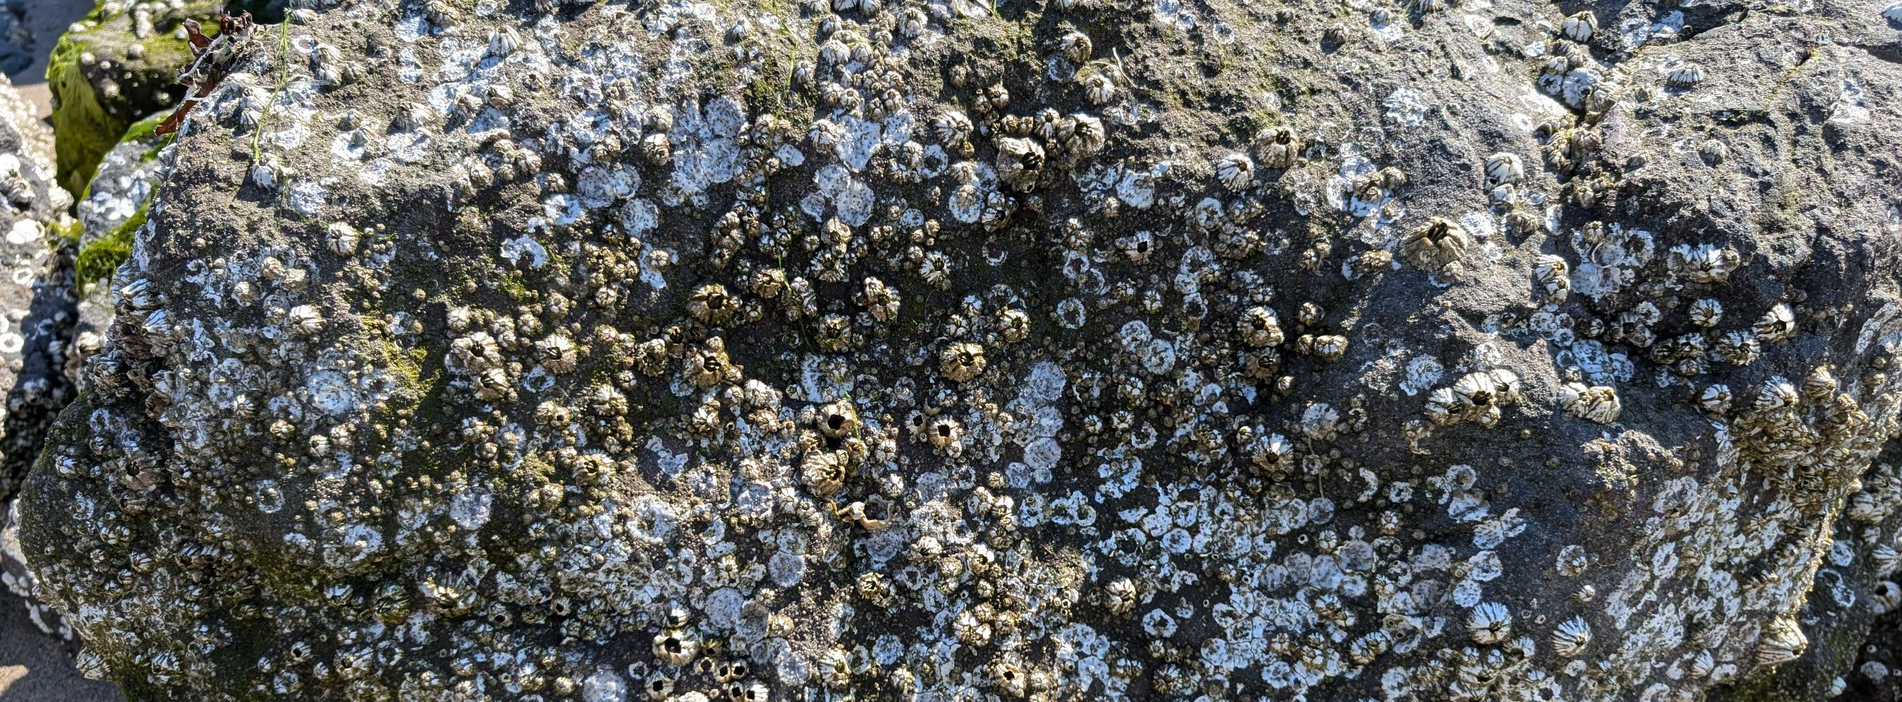
A Spatial Population Genetic Sim of B. glandula in Coos Bay
Alex Bangs – Kern-Ralph Co-Lab - July 2024

Slide 2
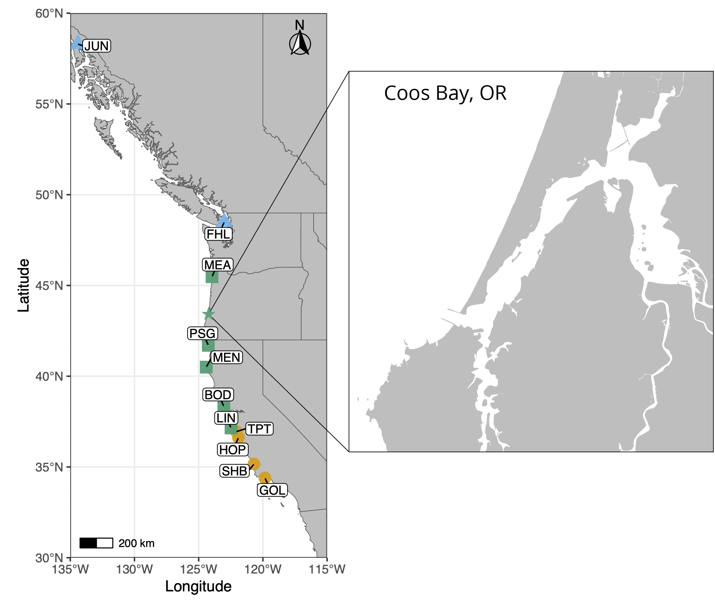
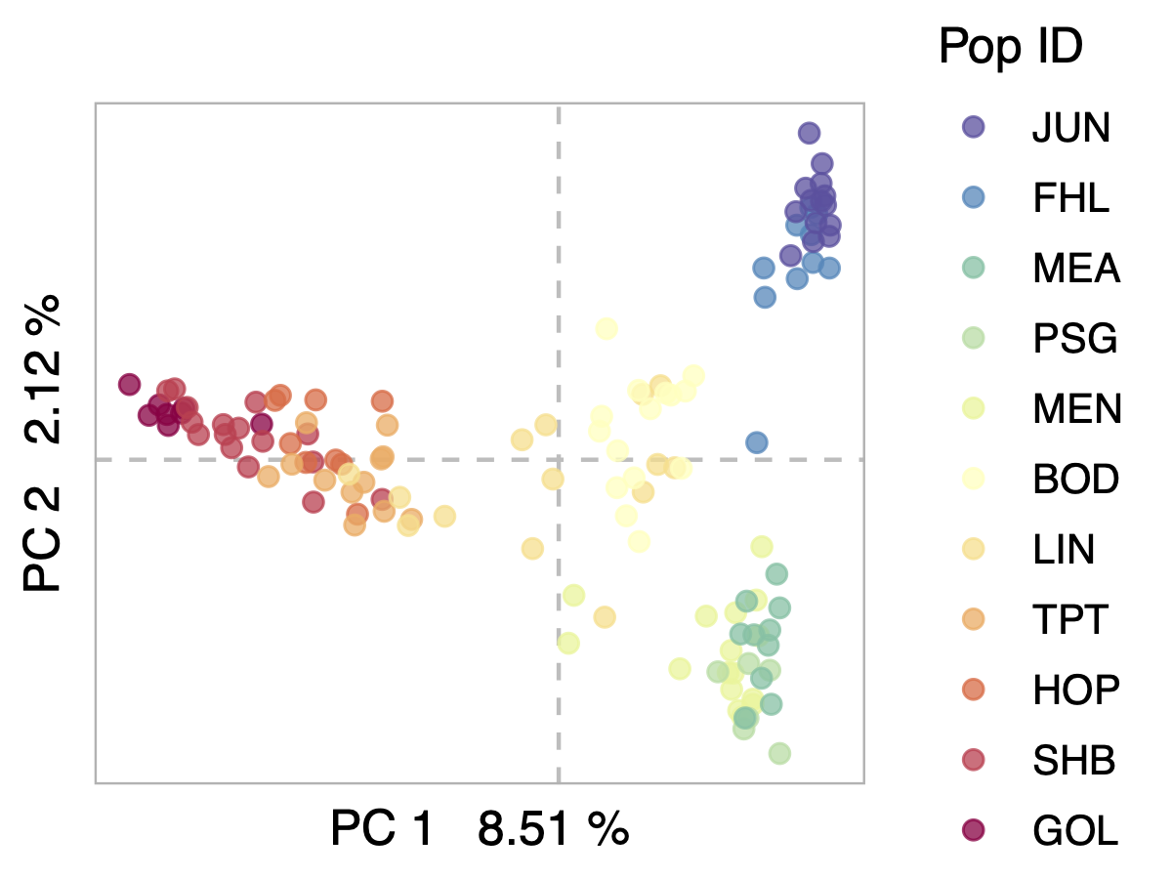
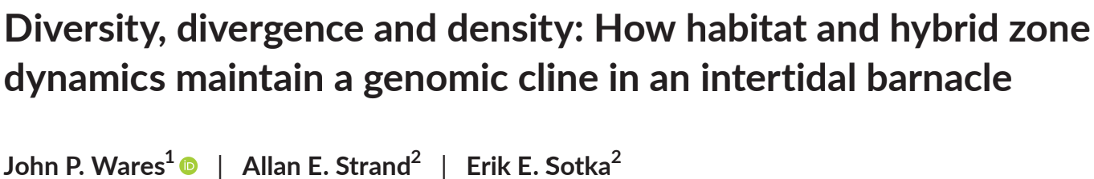
Introduction
Notes:
The lab is studying B. glandula because of how their unique life stages, biological factors, and relationship with their environment impact their population genomics
Simulations are a very powerful tool for studying population genomics, and help ensure our assumptions about B. glandula aren’t unfounded
The Pacific Coast vs Coos Bay

Slide 3
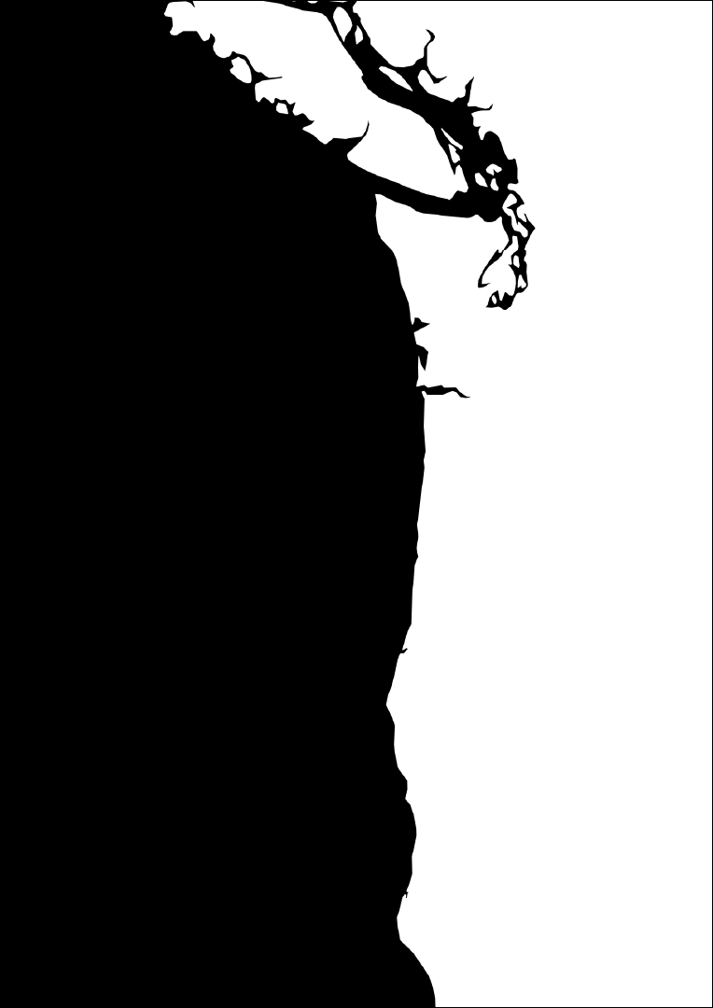
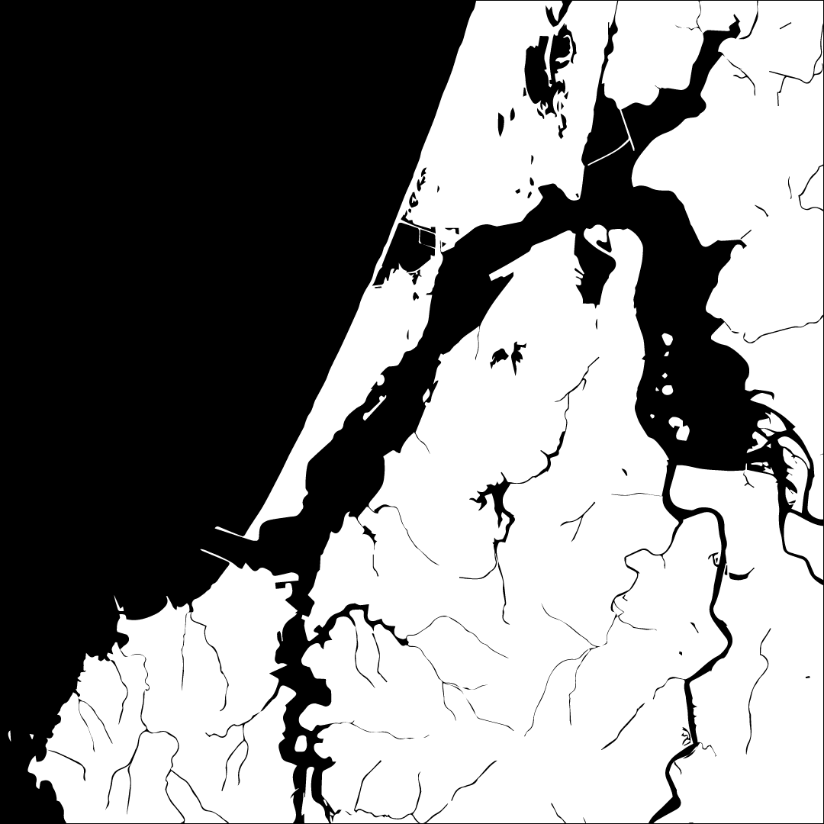
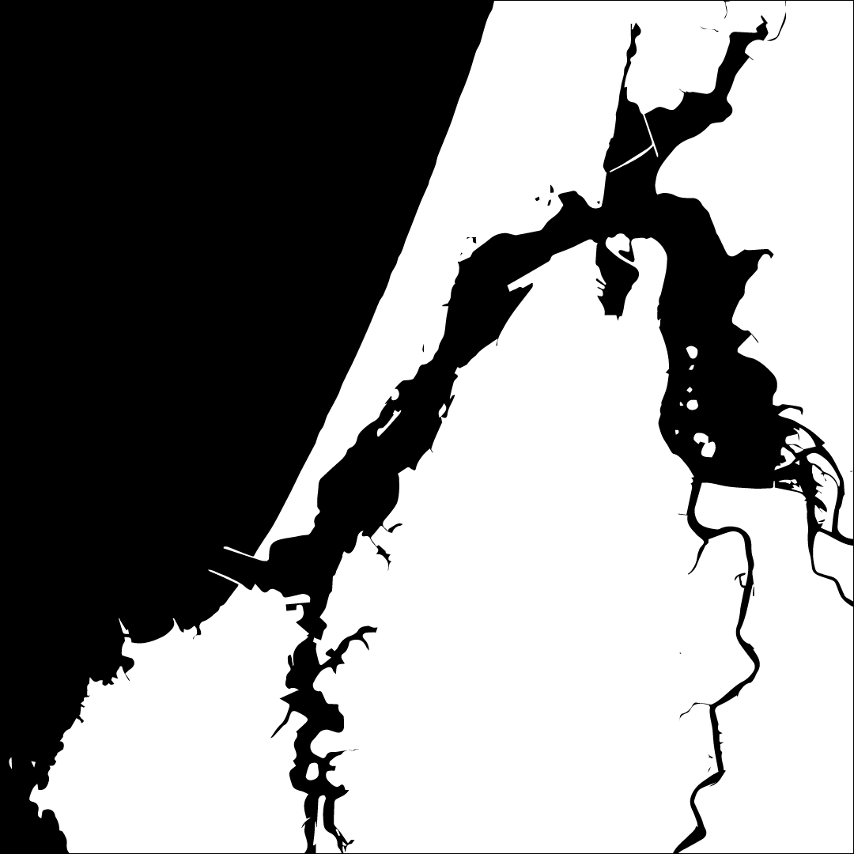
Building Coos Bay - Coastline

Slide 4
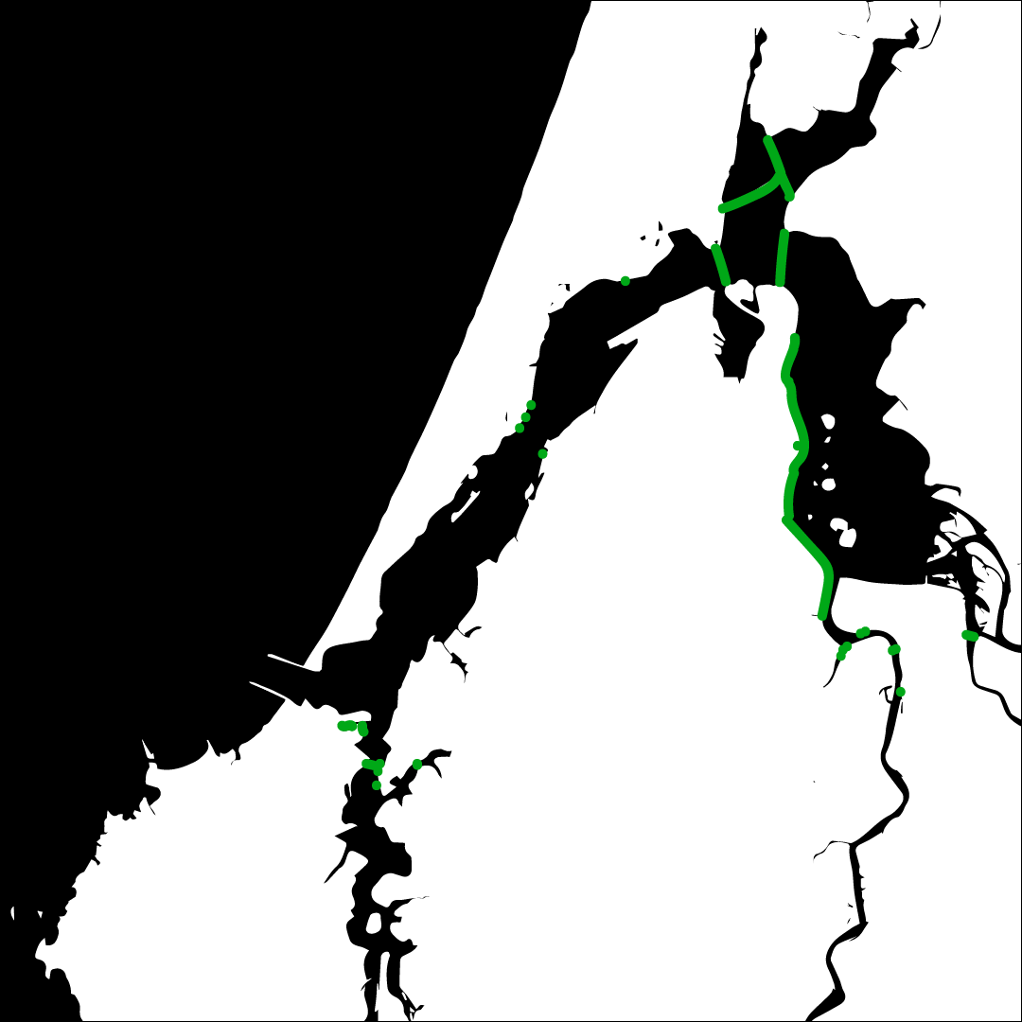
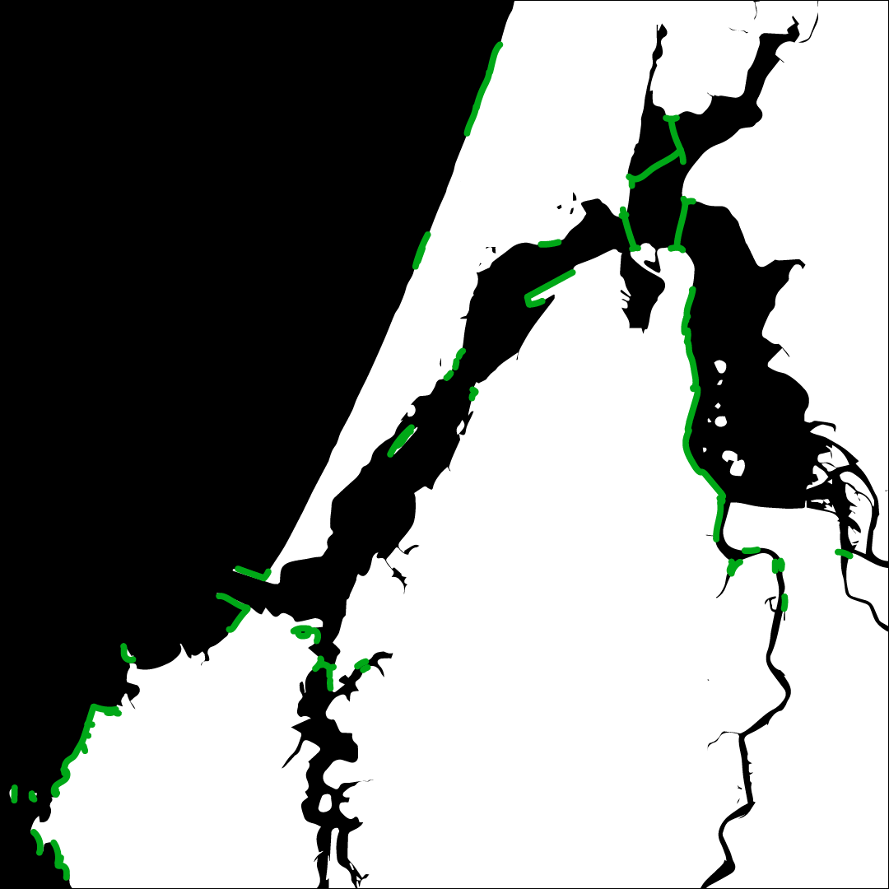
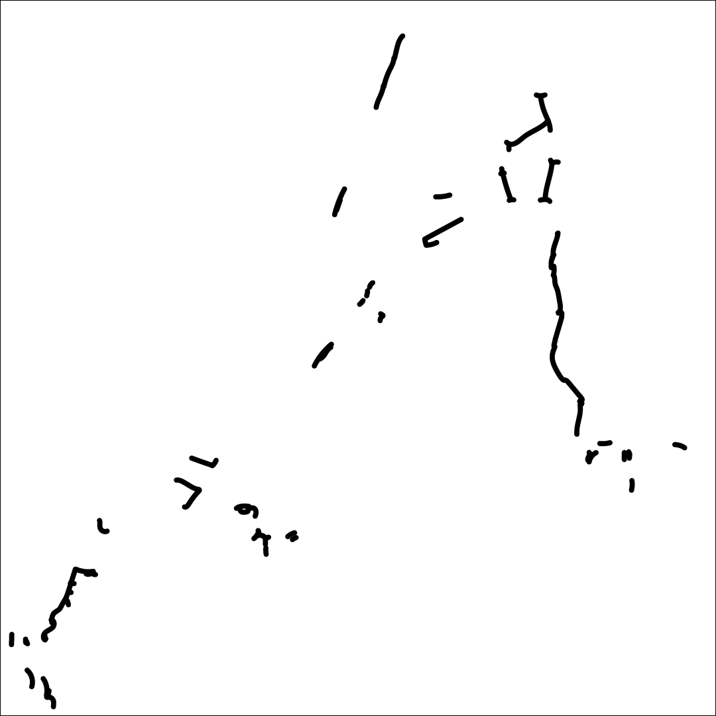
Building Coos Bay - Habitat
Habitat information from the personal observations of OIMB Director Craig Young

Slide 5
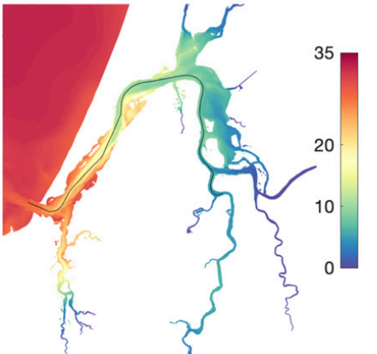
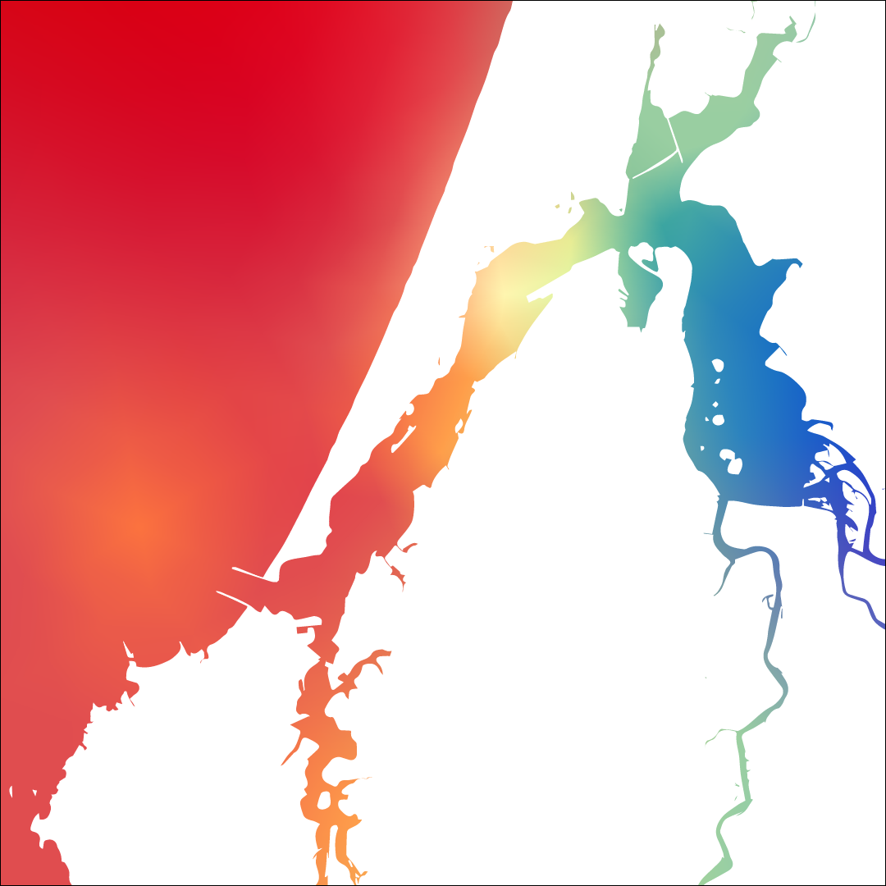

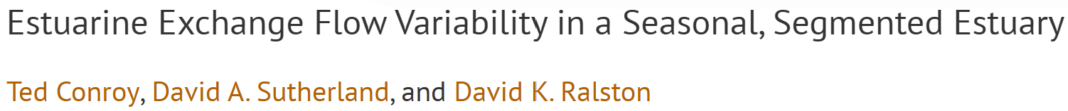
Building Coos Bay - Salinity
Salinity scale measured in PSU (g of salt/L of water)

Slide 6
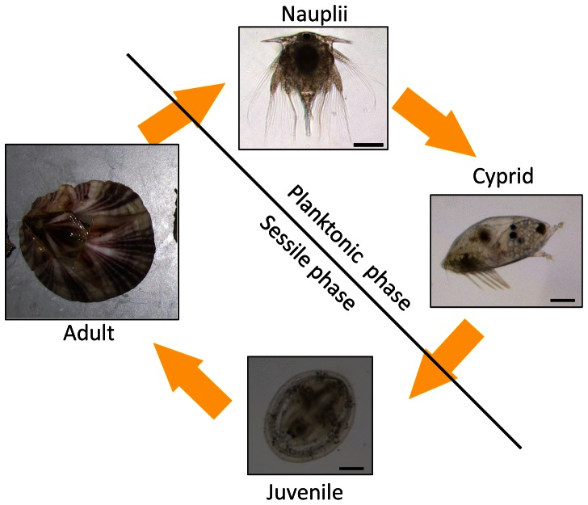
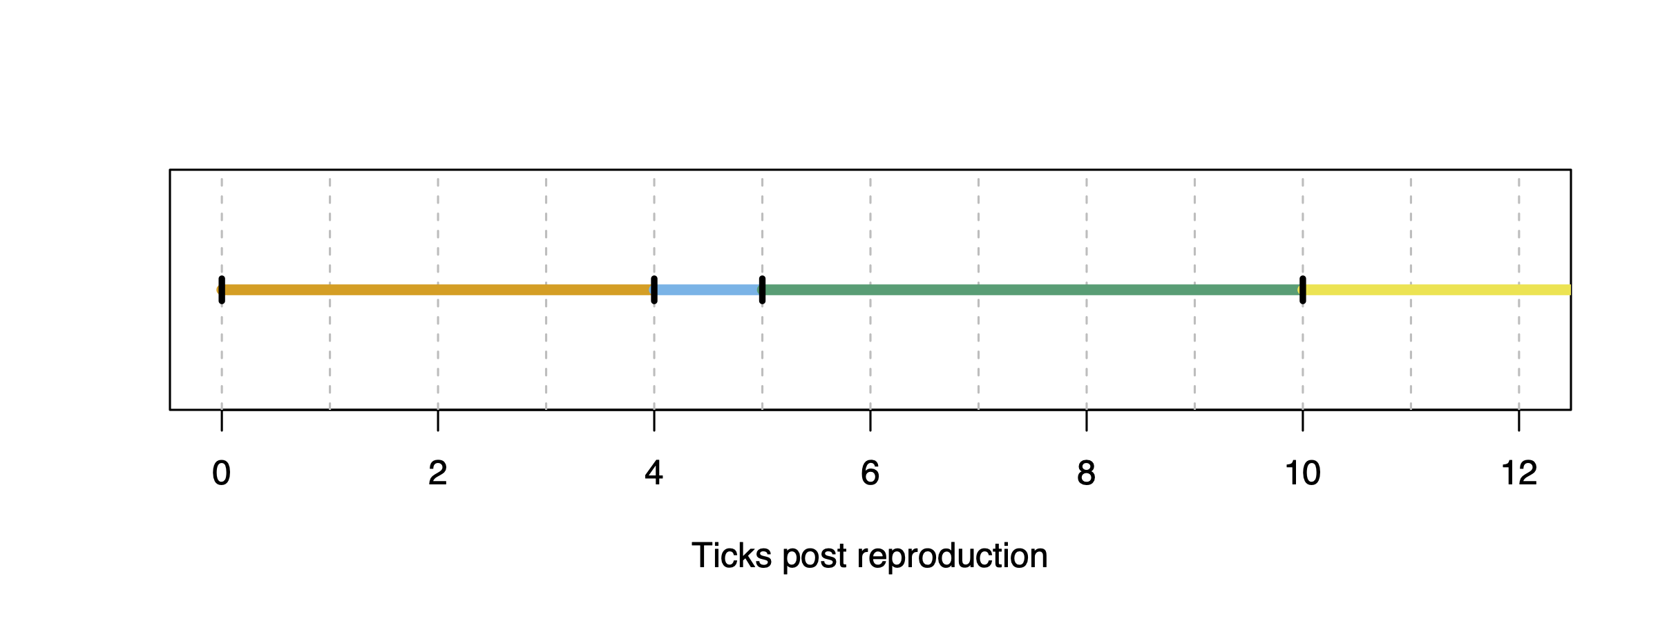
Barnacle Life Stages
Initialize() {
//1. Set biological constants
defineConstant("TICKS_PER_YEAR", 12);
defineConstant("settlementAge", 2); // larval stage is 1 month between dispersal and settlement
defineConstant("maturityAge", 8); // juvenile stage is 6 months between settlement and beginning of brooding
}
Early() {
//1. Define age groups
larvae = p1.subsetIndividuals(maxAge = settlementAge-1);
adults = p1.subsetIndividuals(minAge = settlementAge);
juveniles = p1.subsetIndividuals(minAge = settlementAge, maxAge = maturityAge-1);
new_juveniles = p1.subsetIndividuals(minAge = settlementAge, maxAge = settlementAge);
mature_adults = p1.subsetIndividuals(minAge = maturityAge);
}
Banalus Glandula, OIMB Guide, T.C. Hiebert and M. Jarvis
Notes:
Characterization of Two 20kDa-Cement Protein (cp20k) Homologues in Amphibalanus amphitrite - Scientific Figure on ResearchGate. Available from: https://www.researchgate.net/figure/The-life-cycle-of-barnacle-is-composed-of-two-distinct-phases-planktonic-phase-and_fig1_236959634 [accessed 1 Aug 2024]

Slide 7
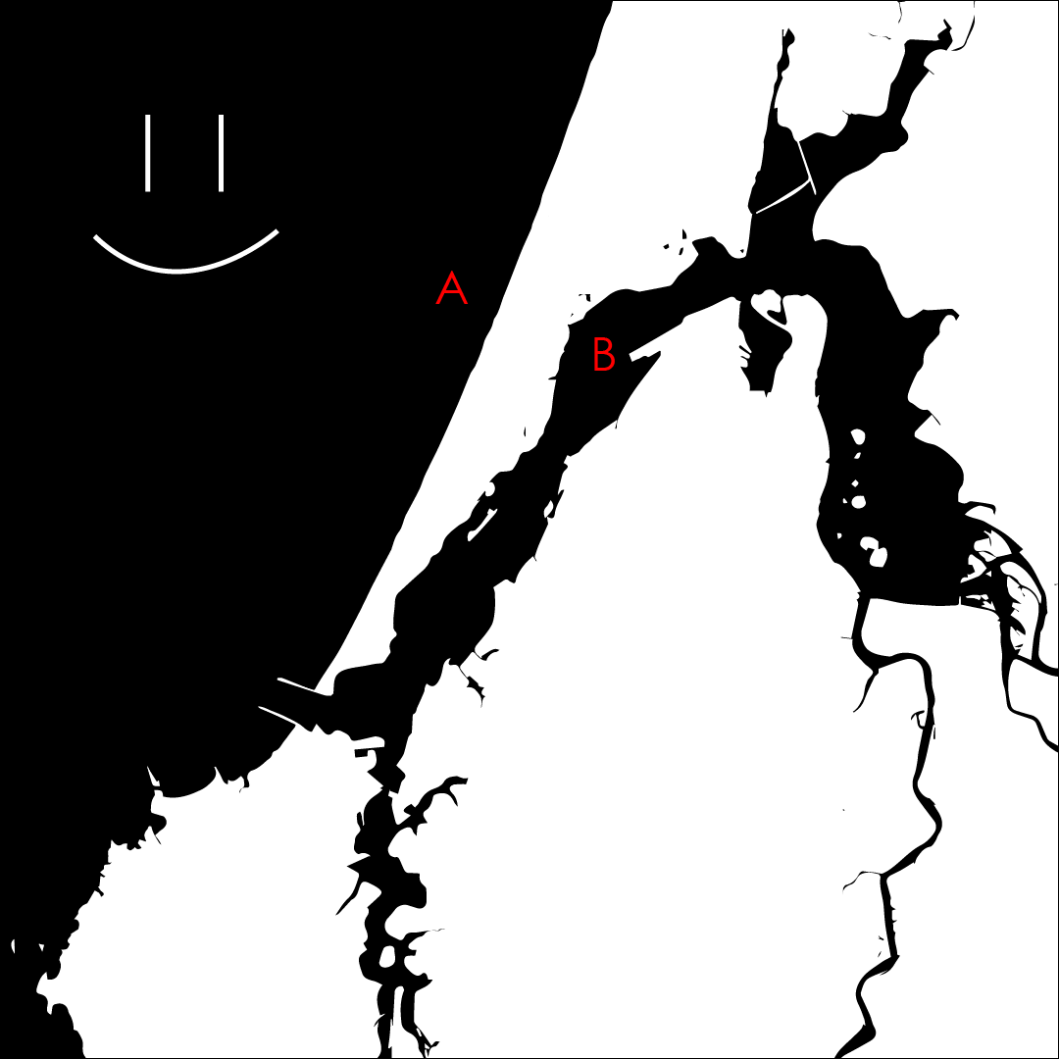
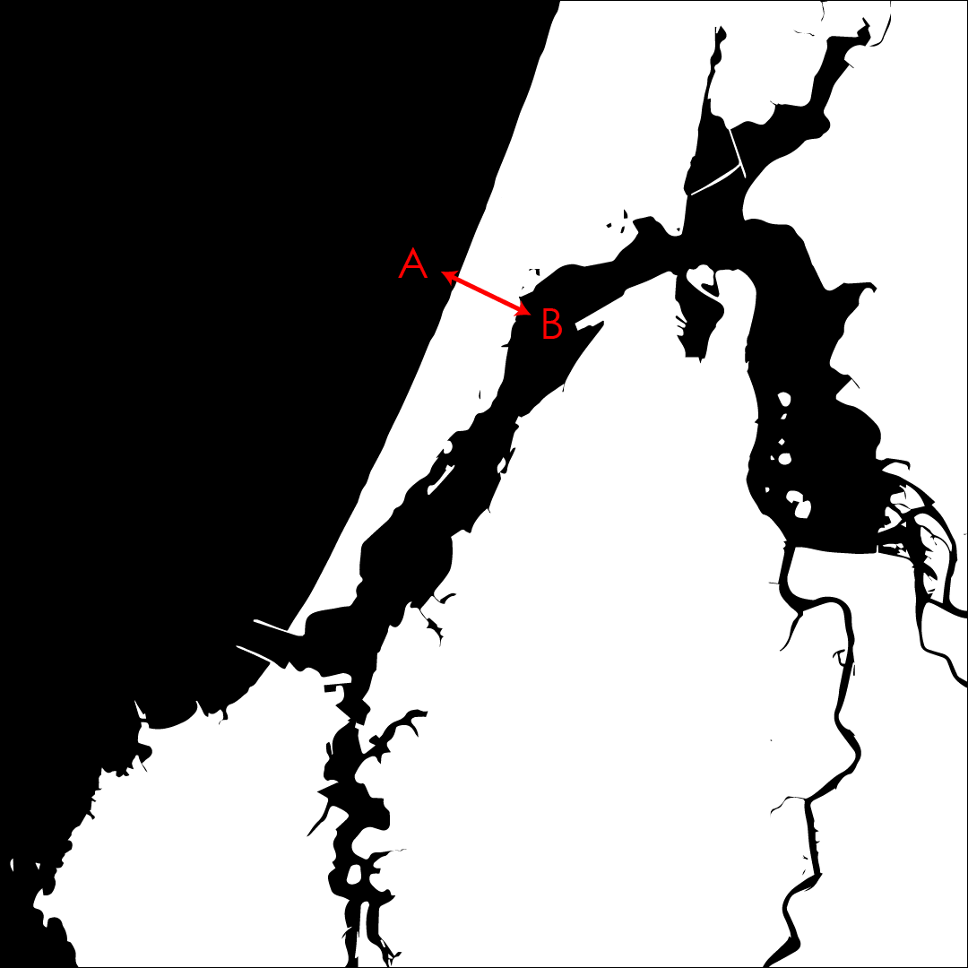
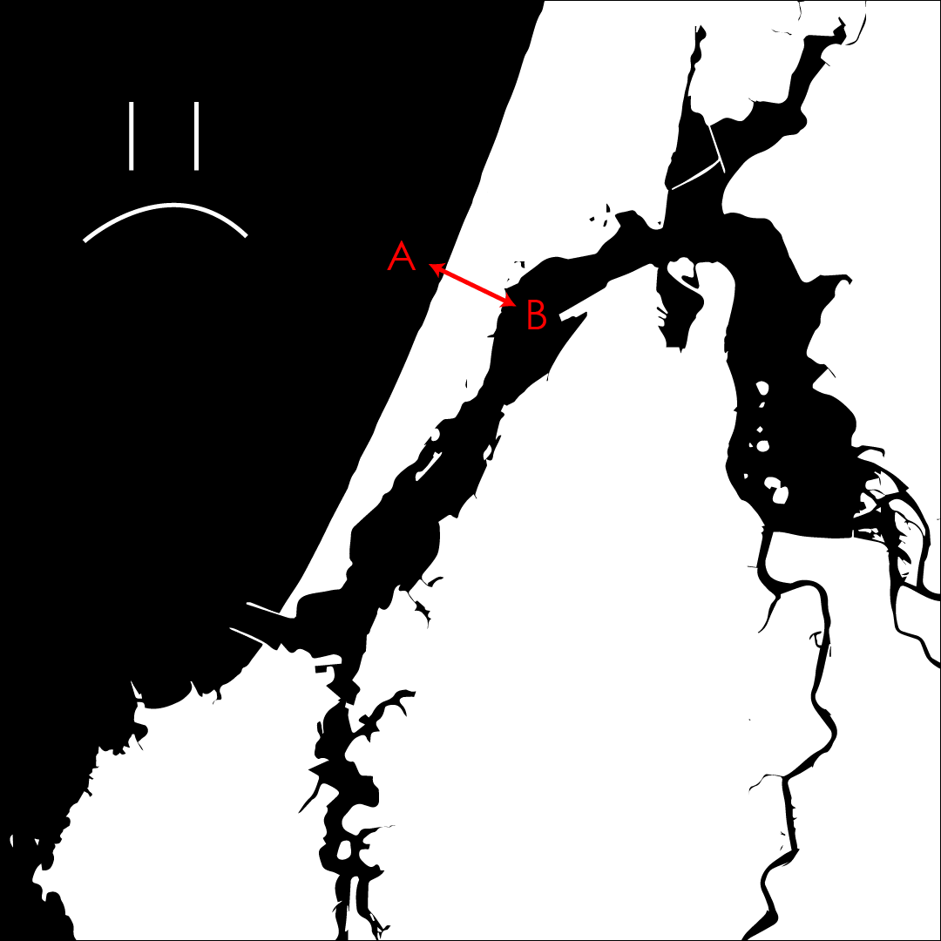
Dispersal
First() {
…
//Move all larvae in the ocean
larvae = p1.subsetIndividuals(maxAge = settlementAge-1);
pos = larvae.spatialPosition;
pos = Map1.sampleNearbyPoint(pos, SJ, "n", SDJ); // SJ is 1.9 and SDJ is 0.975 (1/10 and 1/20 of map size, respectively)
larvae.setSpatialPosition(pos);
}
First() {
…
//Move all larvae in the ocean
step_count = 10;
larvae = p1.subsetIndividuals(maxAge = settlementAge-1);
pos = larvae.spatialPosition;
for (i in 1:step_count)
pos = Map1.sampleNearbyPoint(pos, SJ/(sqrt(10)), "n", SD/(sqrt(10))); // SJ is 1.9 and SD is 0.975 (1/10 and 1/20 of map size, respectively)
larvae.setSpatialPosition(pos);
}
Notes:
Discuss issues with sample nearby point

Slide 8


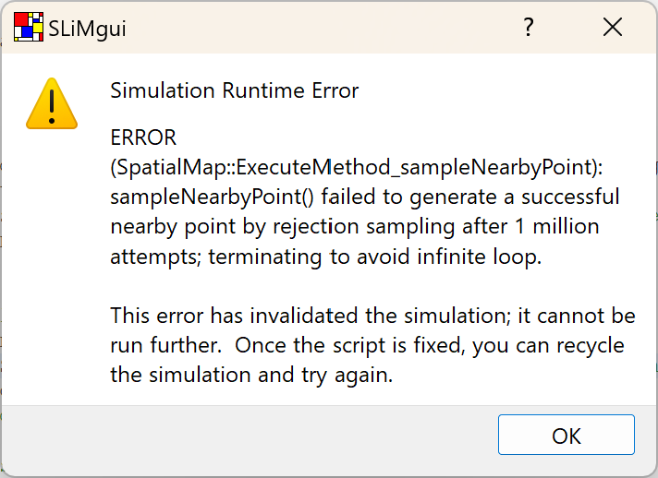
Settlement
Notes:
Discuss issues with sample nearby point

Slide 9
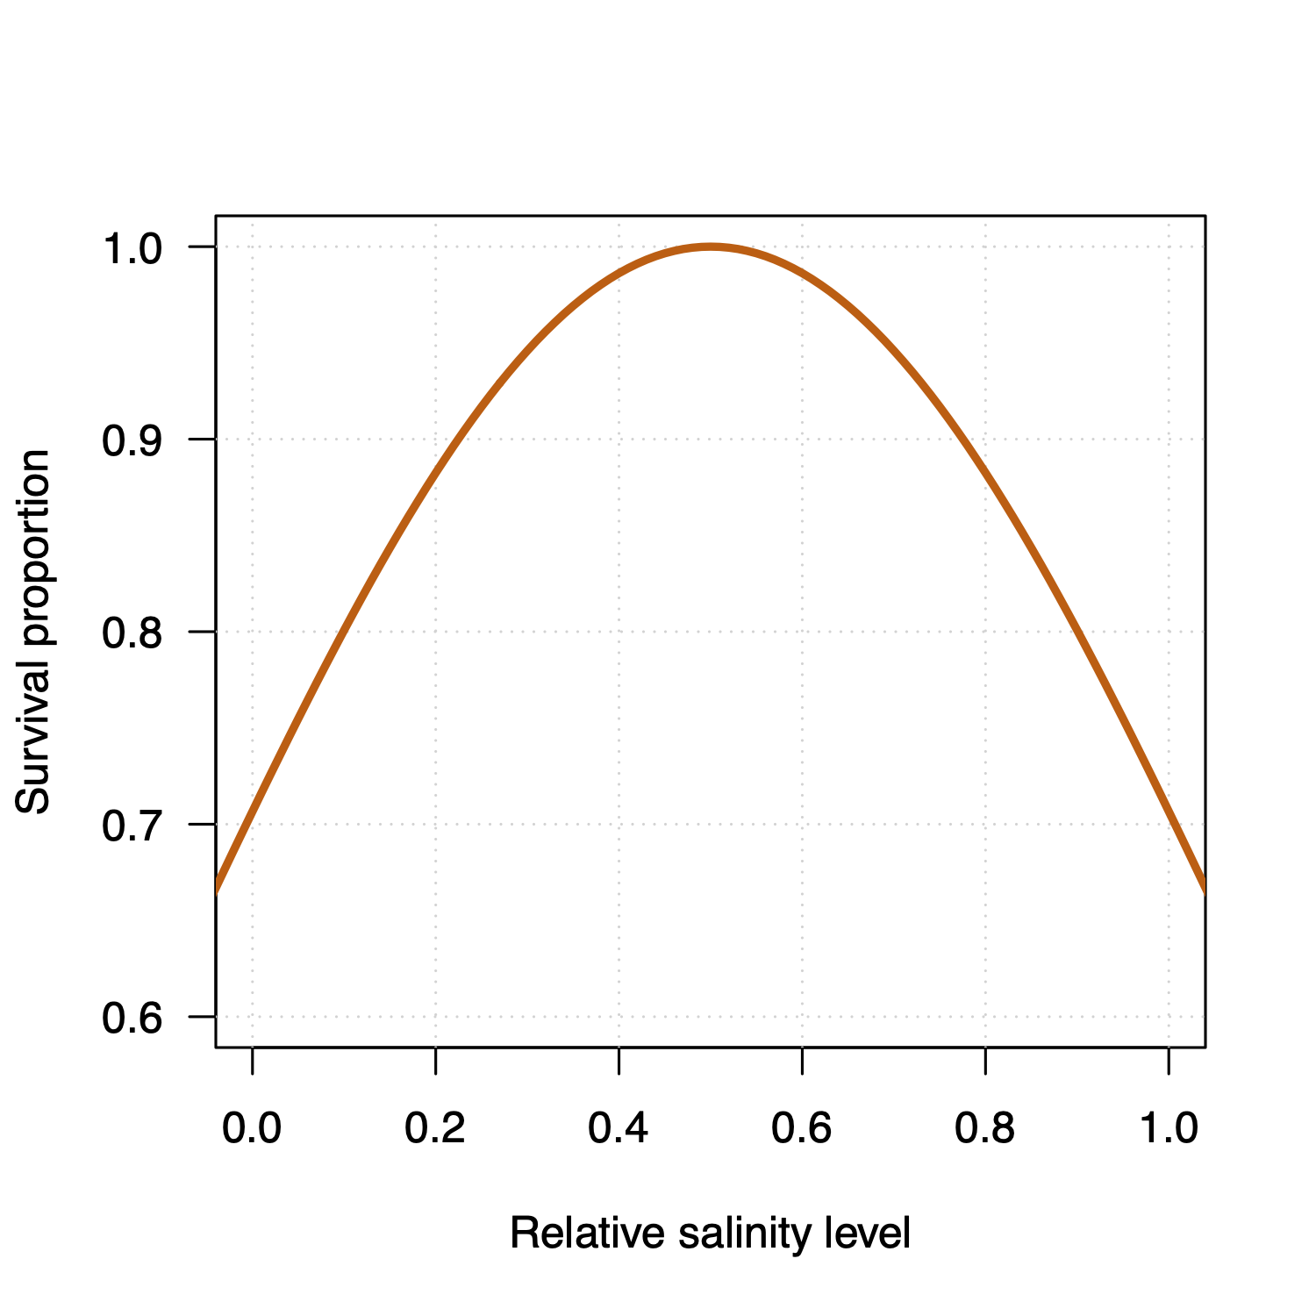

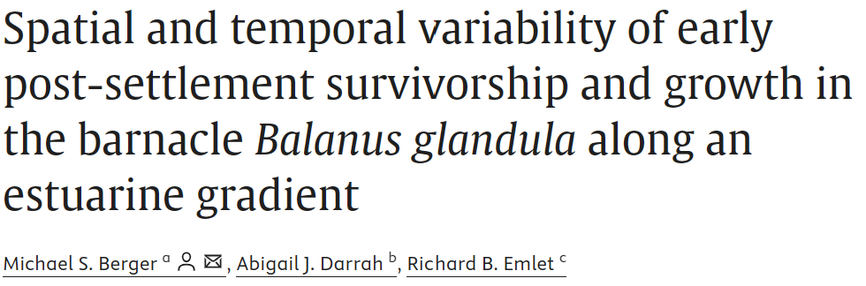
Juvenile Survivorship

Slide 10
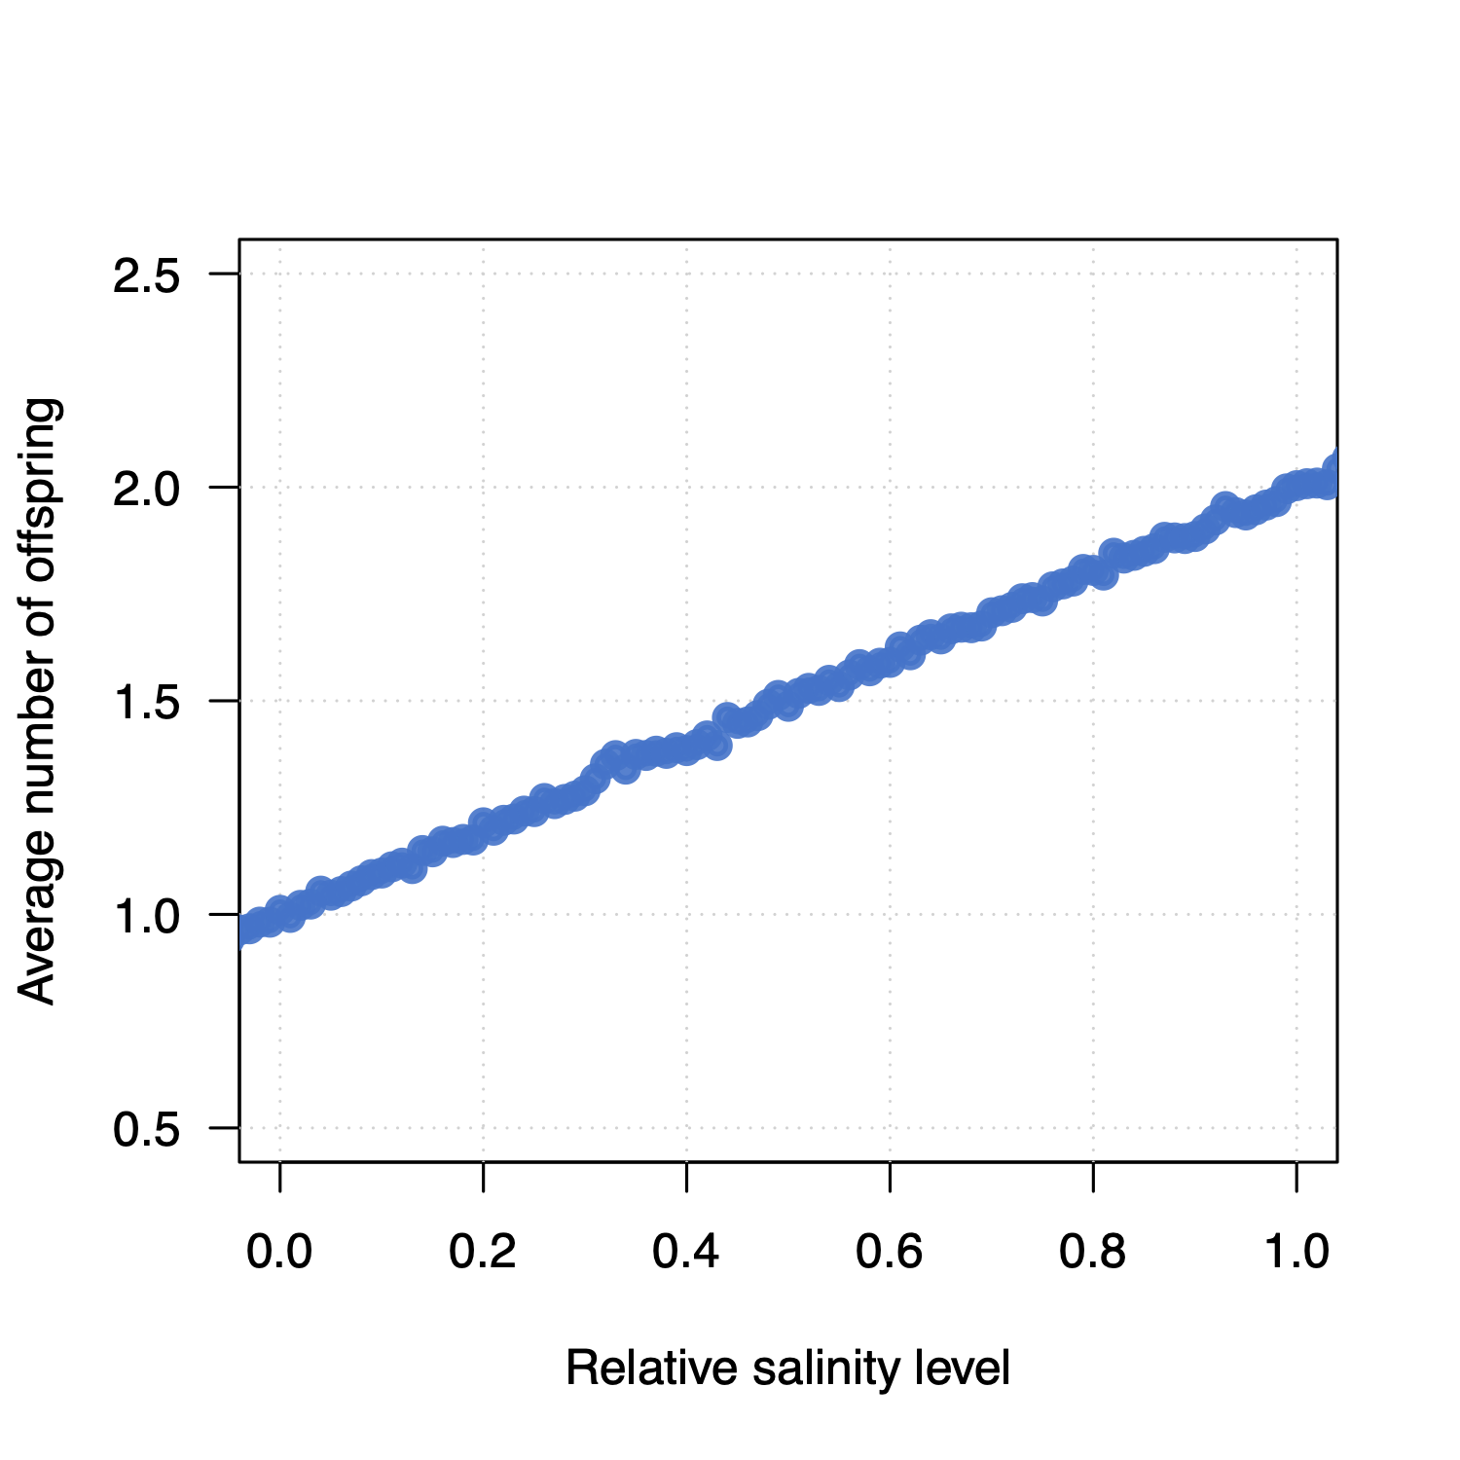
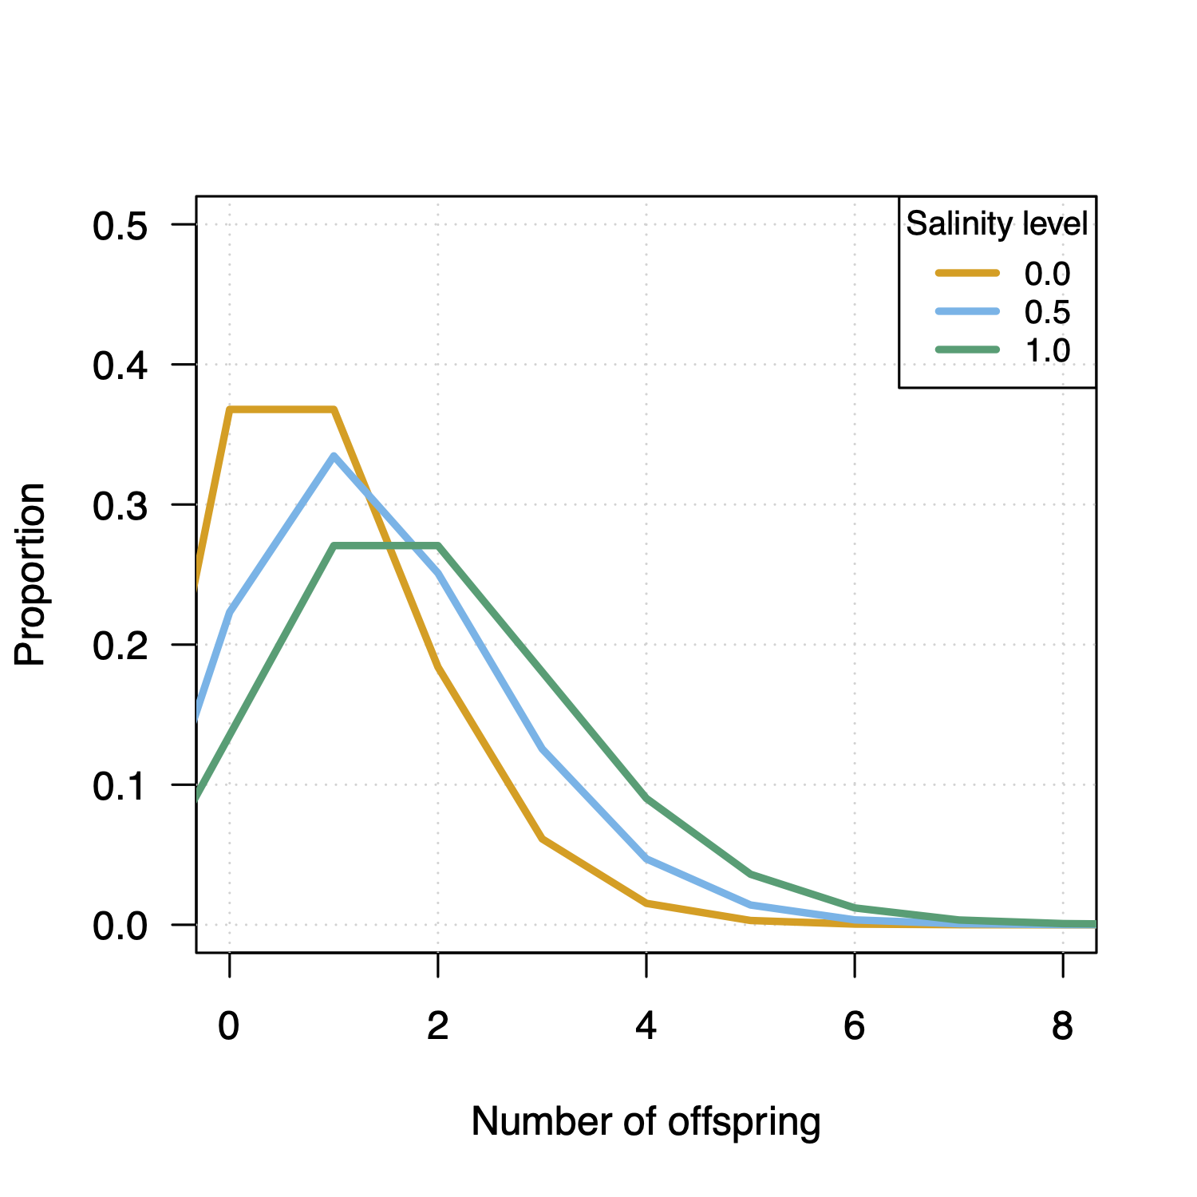
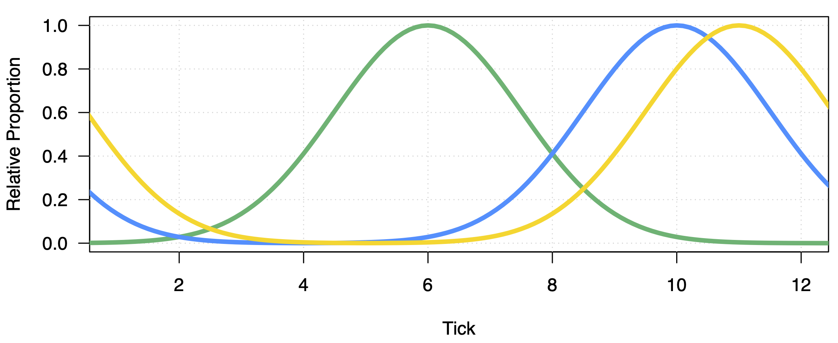
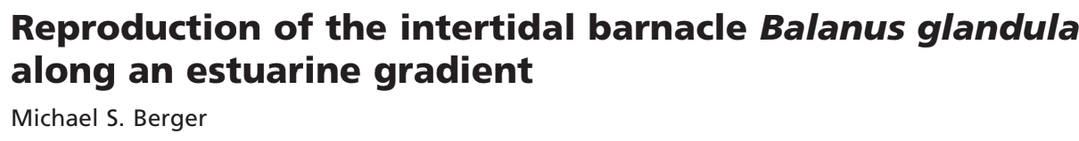
Reproduction
reproduction() {
//1. choose our nearest neighbor as a mate, within the max distance
mate = i2.drawByStrength(individual, 1);
pos = individual.spatialPosition;
//Adjusted Fecundity has direct relationship with salinity
adjustedFecundity = (Fecundity + p1.spatialMapValue("salinity", pos));
//Adjust probability of brooding according time of year
month = (community.tick%TICKS_PER_YEAR)+1;
PBrood = dnorm(month, PBroodMonth, PBroodSD) * (PBroodMax/dnorm(PBroodMonth, PBroodMonth, PBroodSD));
nOff = rpois (1, adjustedFecundity);
if ((mate.size() > 0) & (runif(1) < PBrood) & (nOff>0)) {
p1.addCrossed(individual, mate, count=nOff);
}
}
Banalus Glandula, OIMB Guide, T.C. Hiebert and M. Jarvis

Slide 11
Next Steps
Inclusion of Seasonal Salinity
Predation of adults not accounted for
Align PBROOD distribution up with the actual brooding season
Make sure fitness scaling is accurate
Increasing carrying-capacity and running on Talapas
Diving deeper into TreeSeq and genomic analysis
Make sure fitness scaling is accurate

